Slide 1

Autonomous drone
Chief Mentor: Dr. rer. Nat. D. Antony Louis Piriyakumar,
Mentor: <Prof. Syed hayath>
SPOC: <D.Manoj>
Team members: <Manoj, Neeraj, Edward, Rutu, Shania>

Slide 2

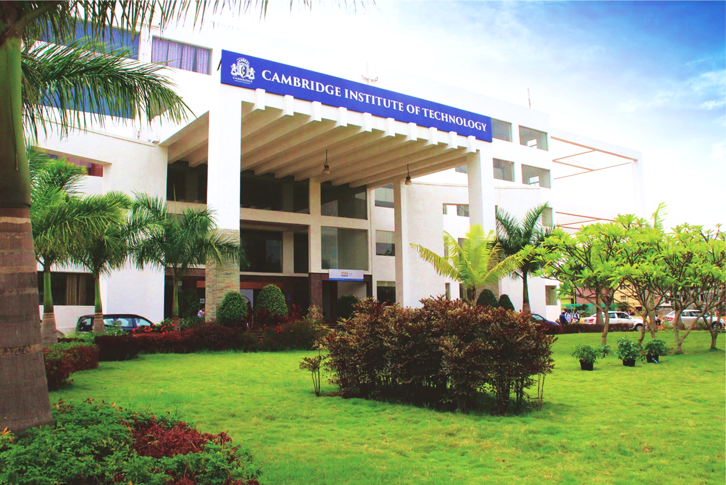
www.cambridge.edu.in
Contents
Reasons for choice
Methodology
Tasks with timelines
Budget required
PPP model
Conclusion
Q&A

Slide 3
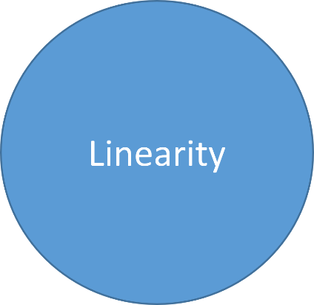
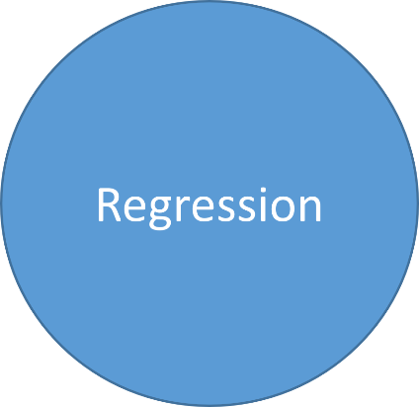
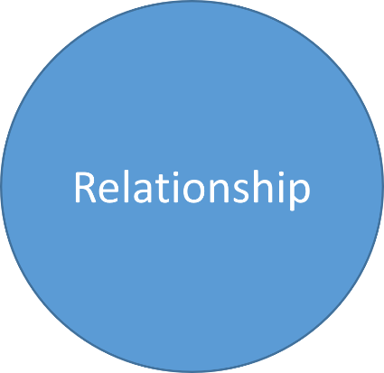
Reasons for choice
Societal
Environmental
Technical

Slide 4

Societal problem
Surveillance
Agriculture
Logistics (current application)
Dean( Research & Development)
www.cambridge.edu.in

Slide 5
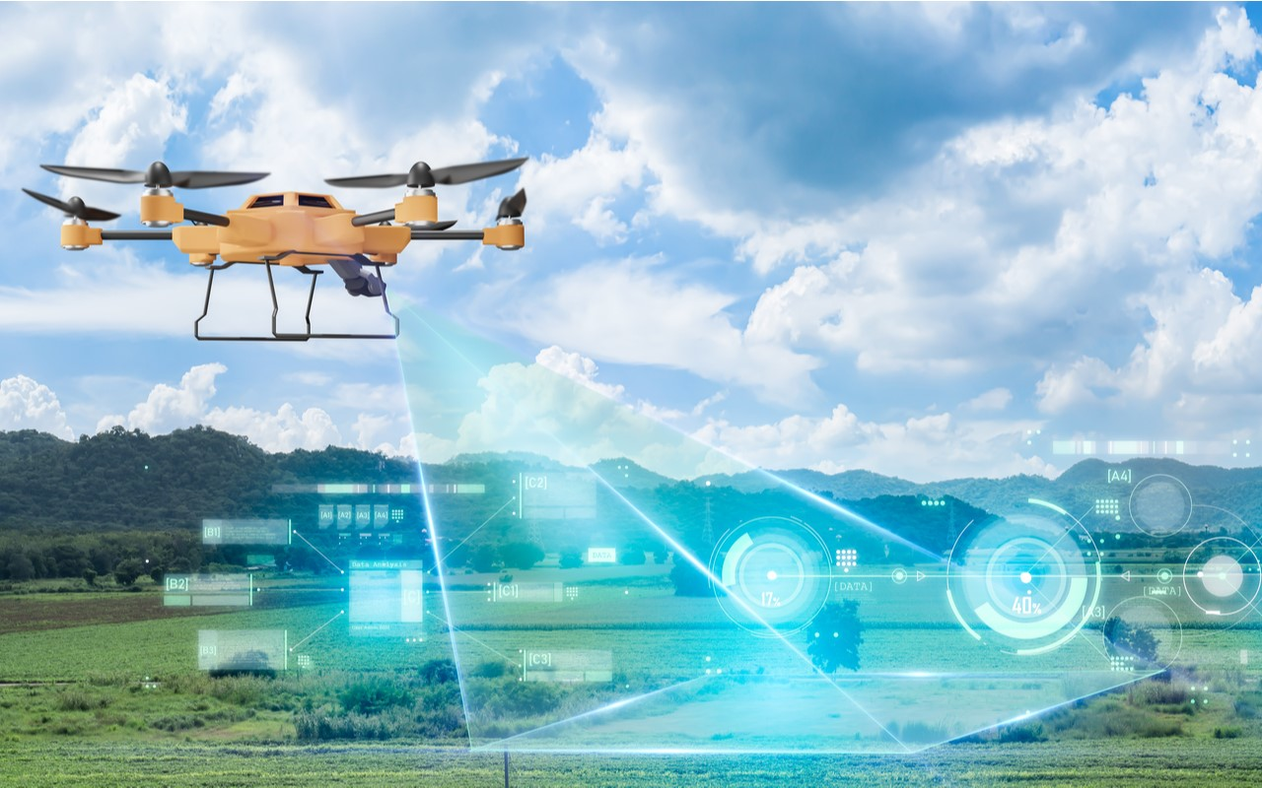
Environmental issue
Plant disease recognition
Wild life protection
Reforestation
Dean( Research & Development)
www.cambridge.edu.in

Slide 6
Technical issues
Flight path planning (collusion avoidance)
Accuracy in flight(location accuracy)
Situational awareness
Dean( Research & Development)
www.cambridge.edu.in

Slide 7
www.cambridge.edu.in
Contents
Reasons for choice
Methodology
Tasks with timelines
Budget required
PPP model
Conclusion
Q&A

Slide 8
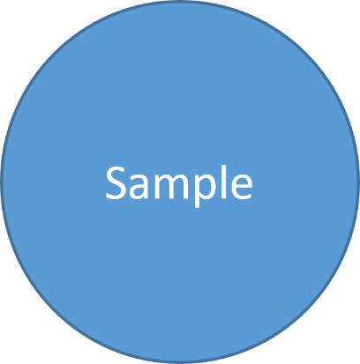
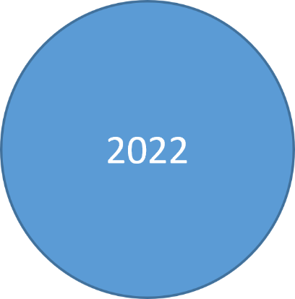
Methodology
Prior art
Approach
Plan

Slide 9
How the problem was solved earlier
The drones did not have the high speed obstacle detection, AI based path reinforcement and ML image recognition.
Recently few institutes have started working on these:-
INSTITUTE OF ZURICH AND INTEL :- high speed fight in the wild.
MIT(Massachusetts Institute of Technology) :- obstacle avoidance
They are at their testing phase
Currently in the market there are drones which are having very high latency in object detection and speed.
Dean( Research & Development)
www.cambridge.edu.in

Slide 10
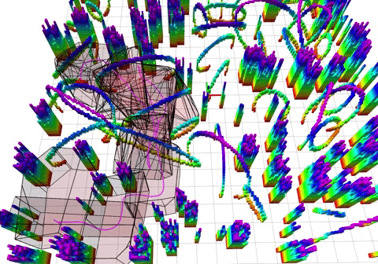
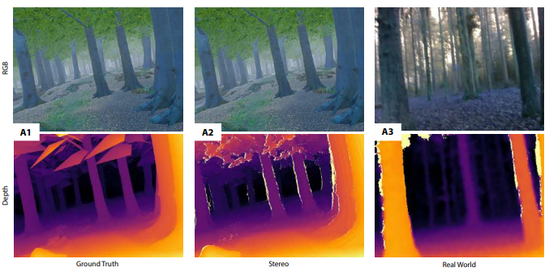
MIT REINFORCEMETN LEARNING
HIGH SPEED FIGHT IN WILD

Slide 11
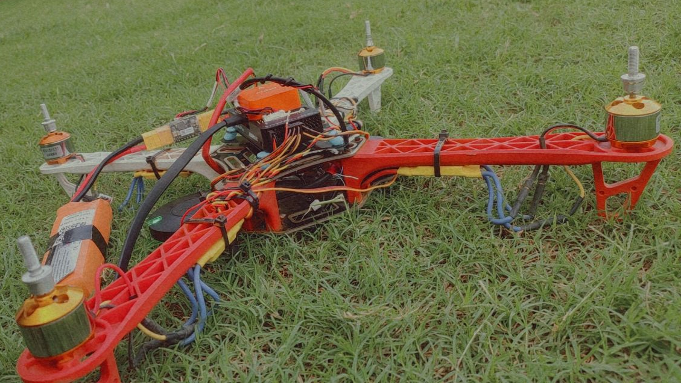
Best way to solve the problem
Installing 2 onboard computers for faster processing speed
Building new firmware for flight controller
Depth sensing camera
Removing the obstacle avoidance sensors.
Modifying the present code for accuracy
Easy to integrate into the drone
More calibration
By integrating all of these components we can achieve accuracy in drone coordination, object detection and speed
Dean( Research & Development)
www.cambridge.edu.in

Slide 12
Plan for solution
To reduce the components integrated into the drone for weight reduction.
Deploying 2 onboard computers.
Building a simulator to simulate Realtime environment.
By reference from research papers by MIT, modifying the algorithm and code a new version of the program.
Dean( Research & Development)
www.cambridge.edu.in

Slide 13
www.cambridge.edu.in
Contents
Reasons for choice
Methodology
Tasks with timelines
Budget required
PPP model
Conclusion
Q&A

Slide 14
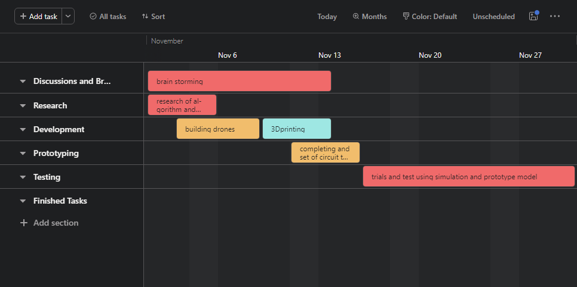
Gantt chart level 0
Dean( Research & Development)
www.cambridge.edu.in

Slide 15
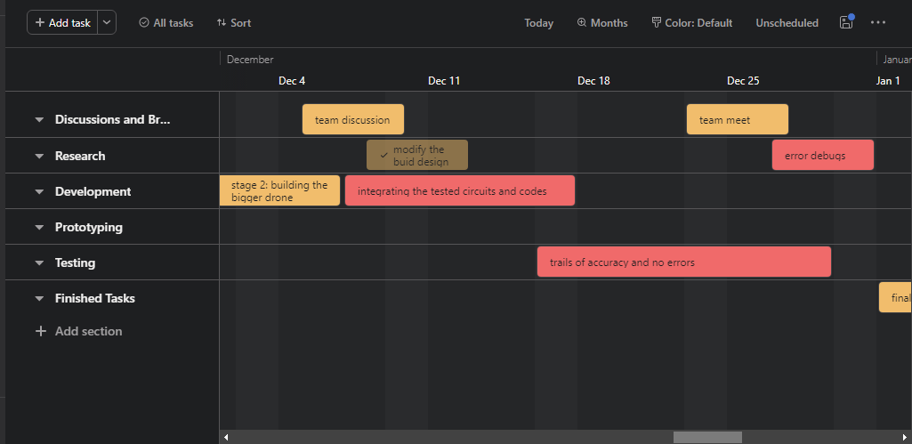
Gantt chart level 1
Dean( Research & Development)
www.cambridge.edu.in

Slide 16
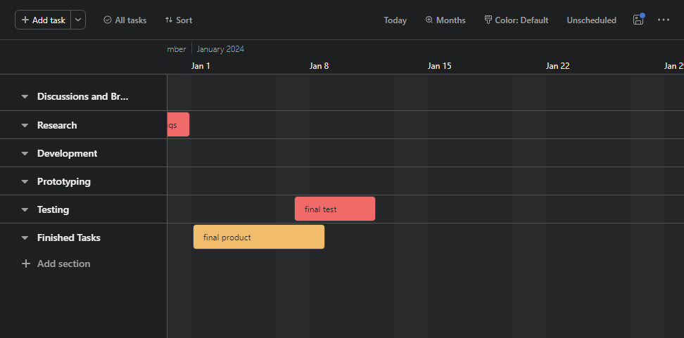
Gantt chart level 2
Dean( Research & Development)
www.cambridge.edu.in

Slide 17
www.cambridge.edu.in
Contents
Reasons for choice
Methodology
Tasks with timelines
Budget required
PPP model
Conclusion
Q&A

Slide 18
Tasks wise budget
The budget is categorized into 2 stage
Protyping approx. budget :- 1,07,048 Rs.
Final product approx. budget :- 2,08,000 Rs.
On approx. total budget needed :- 3,15,048 Rs.
Dean( Research & Development)
www.cambridge.edu.in

Slide 19
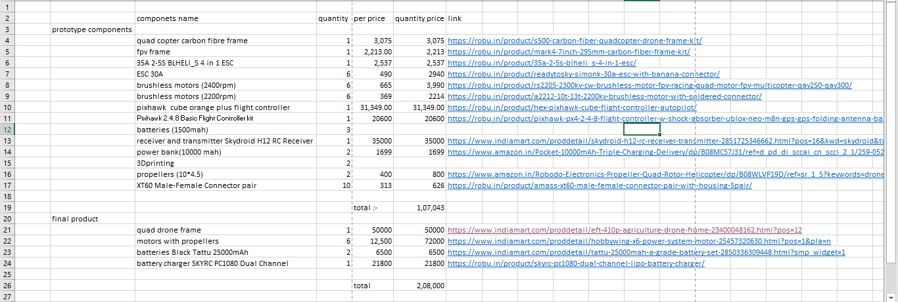
H/w Component wise budget
Dean( Research & Development)
www.cambridge.edu.in

Slide 20
S/w Component wise budget
Simulink (license with college)
MATLAB (license with college)
Vnc viewer server
Dean( Research & Development)
www.cambridge.edu.in

Slide 21
www.cambridge.edu.in
Contents
Reasons for choice
Methodology
Tasks with timelines
Budget required
PPP model
Conclusion
Q&A

Slide 22
Patents
Autonomous UAV obstacle avoidance using machine learning from piloted UAV flights(US11087632B1)
Dean( Research & Development)
www.cambridge.edu.in

Slide 23
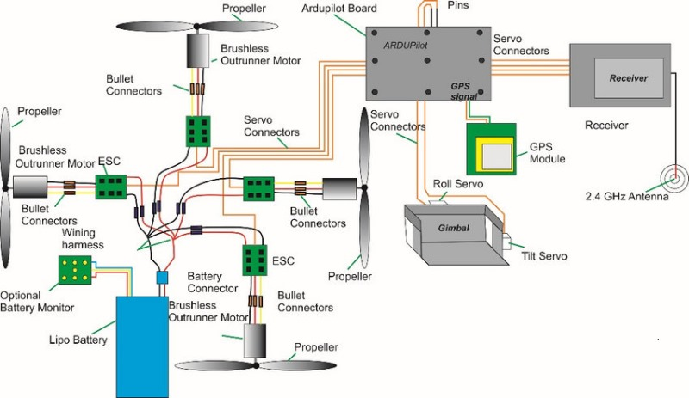
Power distribution
Dean( Research & Development)
www.cambridge.edu.in

Slide 24
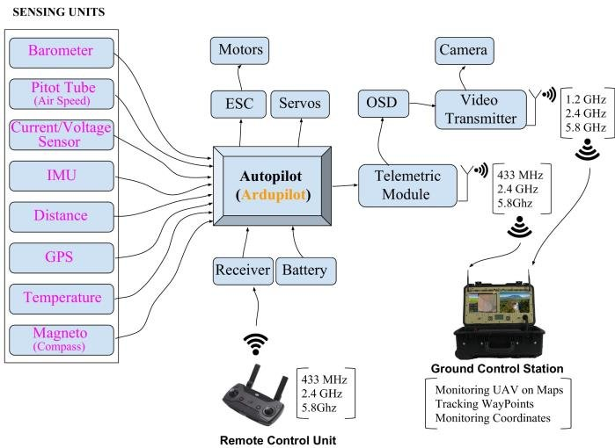
communication
Dean( Research & Development)
www.cambridge.edu.in

Slide 25
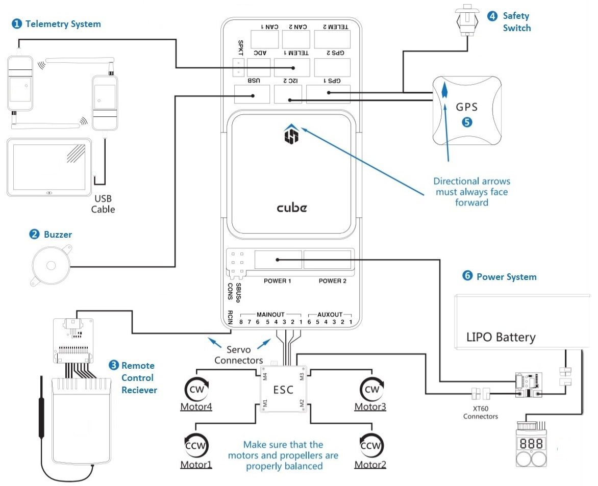
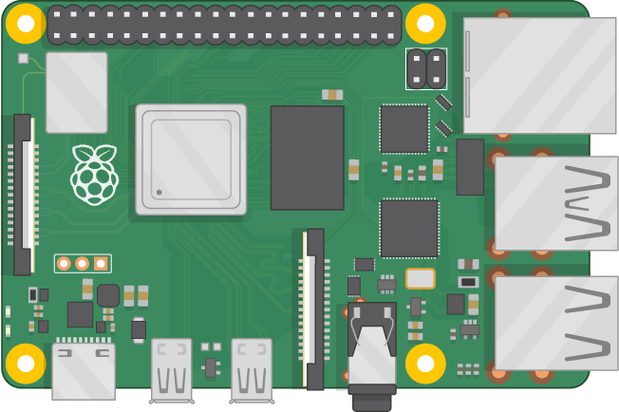
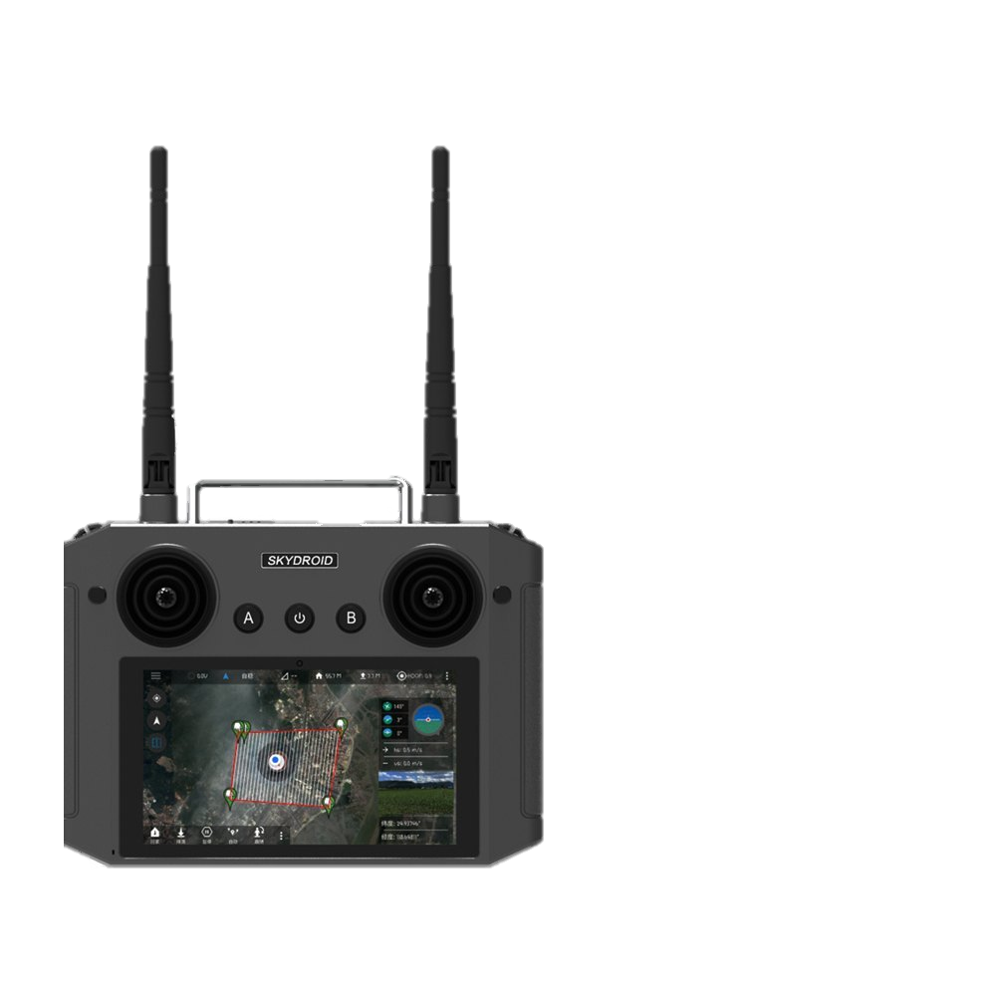
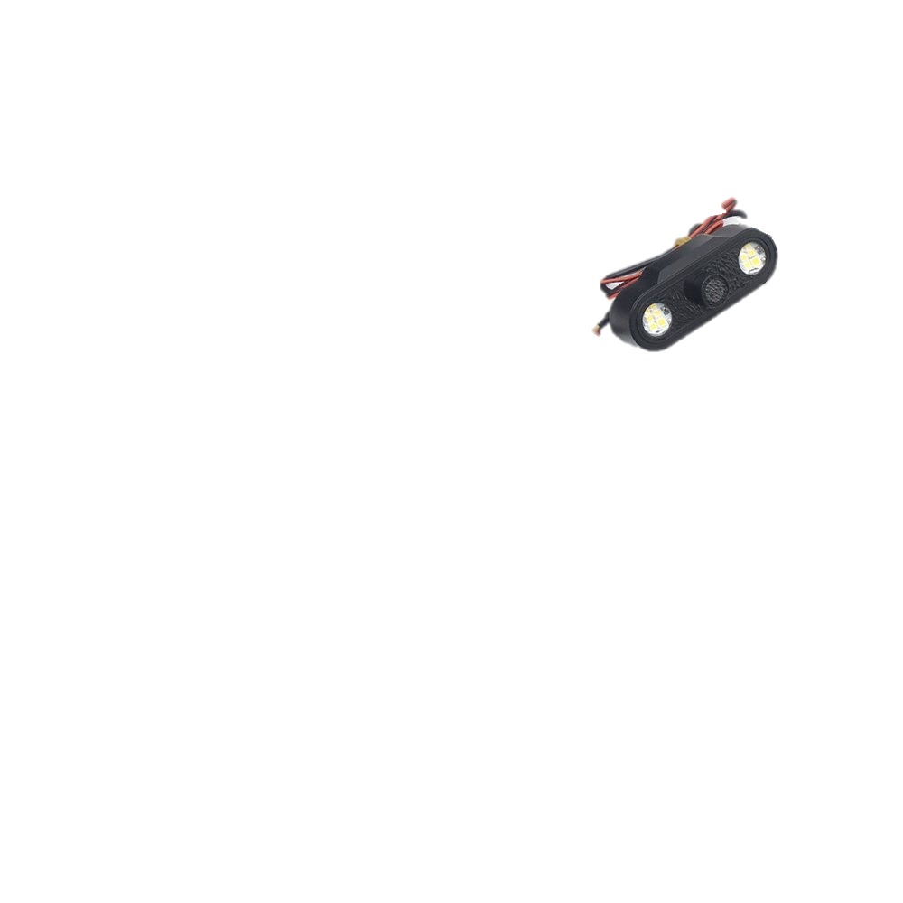
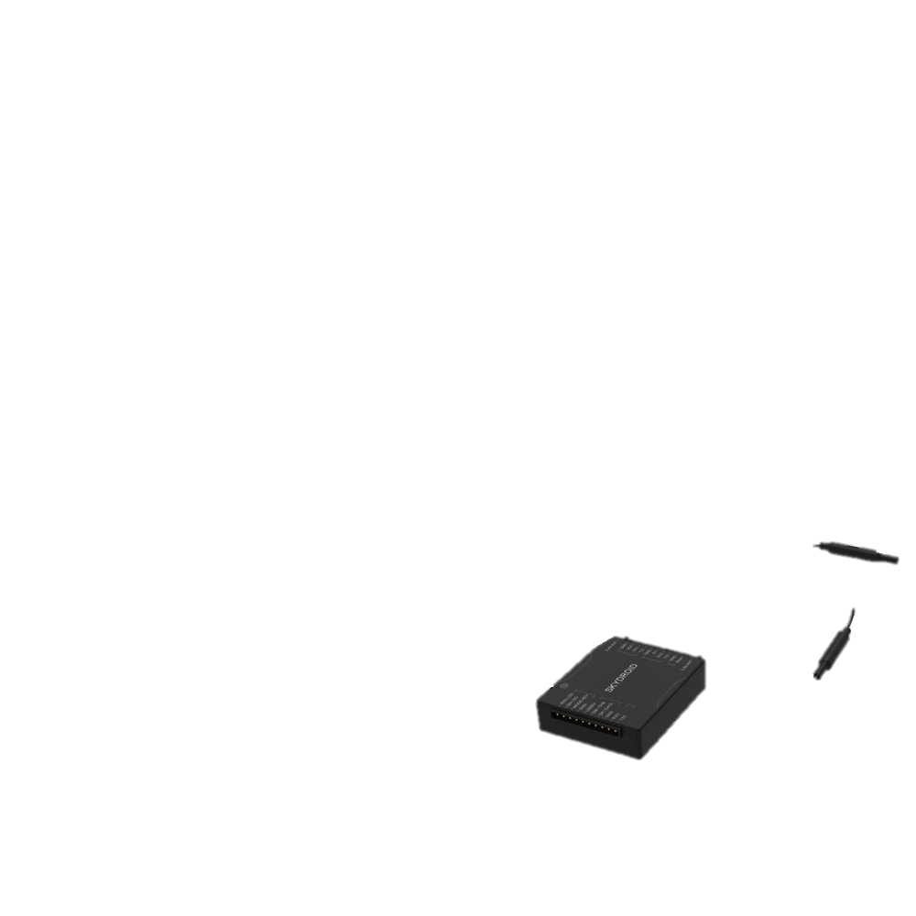
Overall circuit
TX
RX
Dean( Research & Development)
www.cambridge.edu.in

Slide 26
www.cambridge.edu.in
Contents
Reasons for choice
Methodology
Tasks with timelines
Budget required
PPP model
Conclusion
Q&A

Slide 27
Conclusion
autonomous fly of UAV
Control code
Application specific code
patenting/paper
Dean( Research & Development)
www.cambridge.edu.in

Slide 28
www.cambridge.edu.in
Contents
Reasons for choice
Methodology
Tasks with timelines
Budget required
PPP model
Conclusion
Q&A

Slide 29
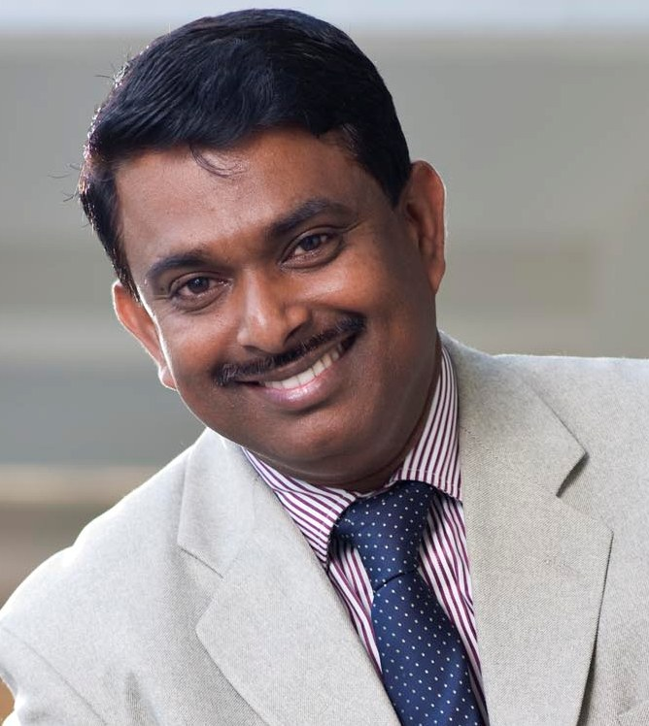
Contact
Prof. D. Antony Louis Piriyakumar Dean (Research and development) Cambridge Institute of Technology
K.R. Puram, 560036 Bengaluru, India
Mobile: +91 98459 25132
E-mail: dean_rd@Cambridge.edu.in

